Slide 1
Data engineering final project Team member
Andrew
Fatbe
Gary
Leslie

Slide 2
Project Objective:
Help our client, Olist to analysis their dataset in below 3 main steps:
Dataset cleaning/ profiling
Data Visualization
Data Analysis

Slide 3
What is Olist?
Olist is the leading SMB commerce enabler ecosystem, operating in 3 dimensions: Commerce, Logistics and Capital.
Employee: Over 1000 people

Slide 4
What we want to answer in this project?
Data Visualization part:
How many customers, orders, and orders per customer does the company have?
What is the number of customers by state?
What is the number of orders by month?
What are the top 5 product categories?
Visualize the company’s customers’ demographics, sales trend, orders by categories, orders changes by year

Slide 5

Data Analysis part:
Feedback Sentiment Analysis
Sales Prediction
☺ Analysis helps me a lot! Thanks Gary!

Slide 6
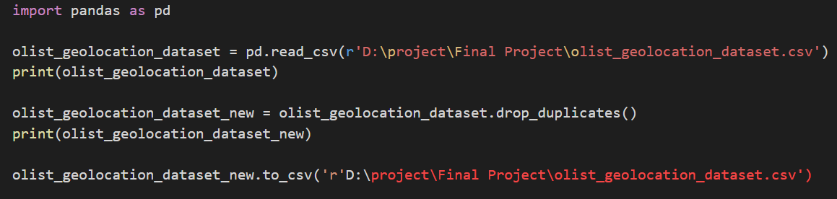
About Dataset cleaning

Slide 7
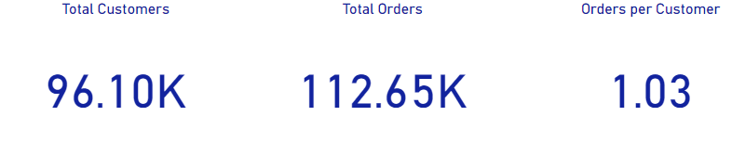
How many customers, orders, and orders per customer does the company have?

Slide 8
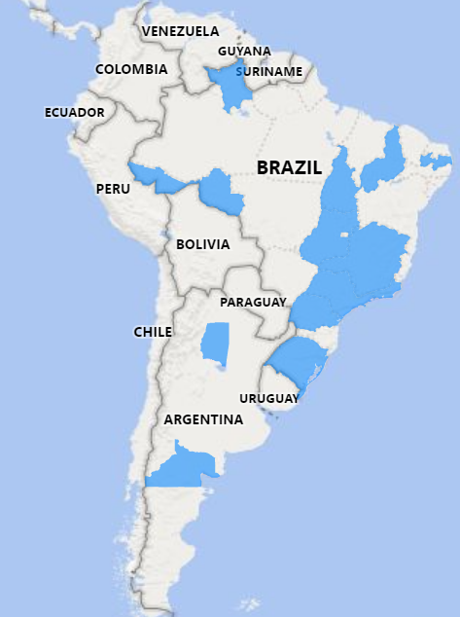
1. SAO PAULO – 40.30K the most populous city in Brazil (Financial Center) 2. Minas Gerais – 11.26k the second most populous This 2 cities contents most of the customer’s size
What is the number of customers by state?

Slide 9
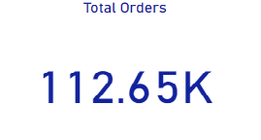
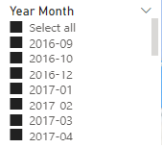
What is the number of orders by month?

Slide 10
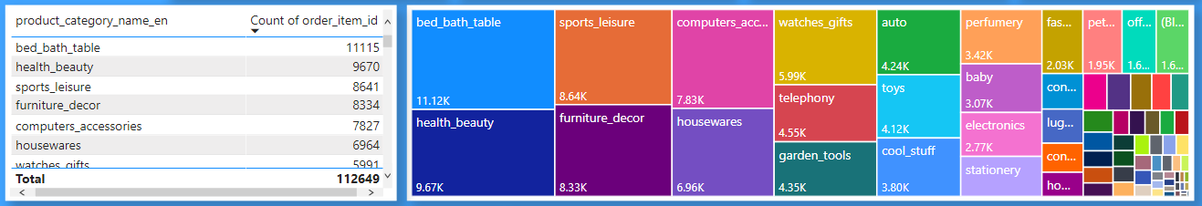
1. Luxury bedding/ Homeware 2. Healthcare/ loss-weight 3. Sport related 4. movie decoration/ partyroom decoration 5. Accessories
What are the top 5 product categories?

Slide 11
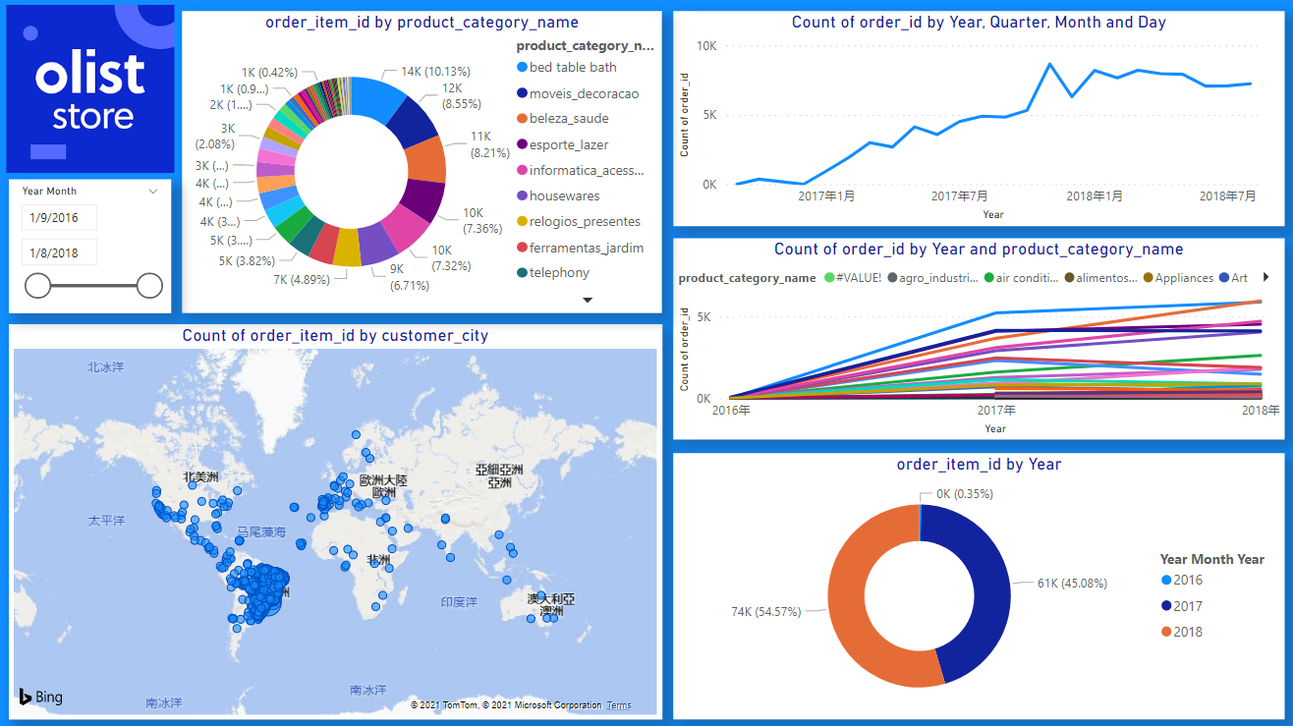
Visualize the company’s customers’ demographics, sales trend, orders by categories, orders changes by year

Slide 12
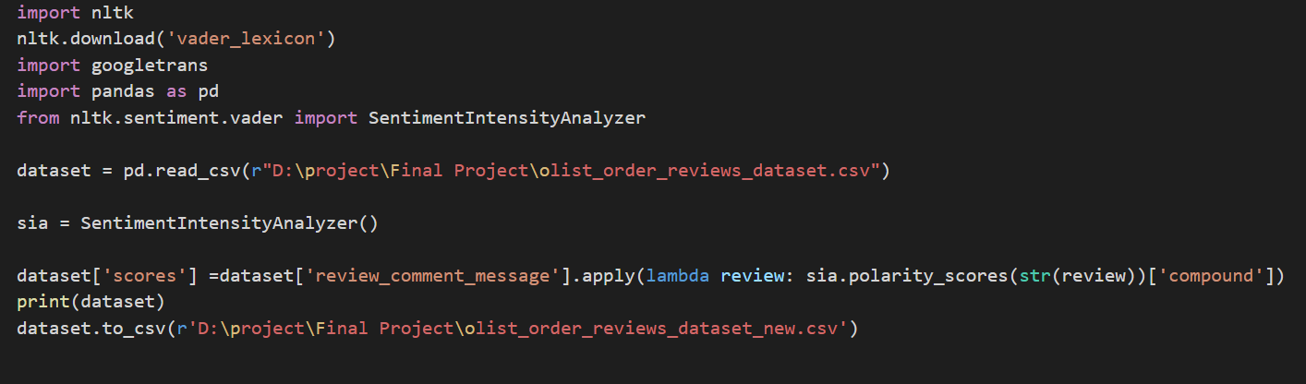
☺ We can see the result in next page!
Feedback Sentiment Analysis

Slide 13
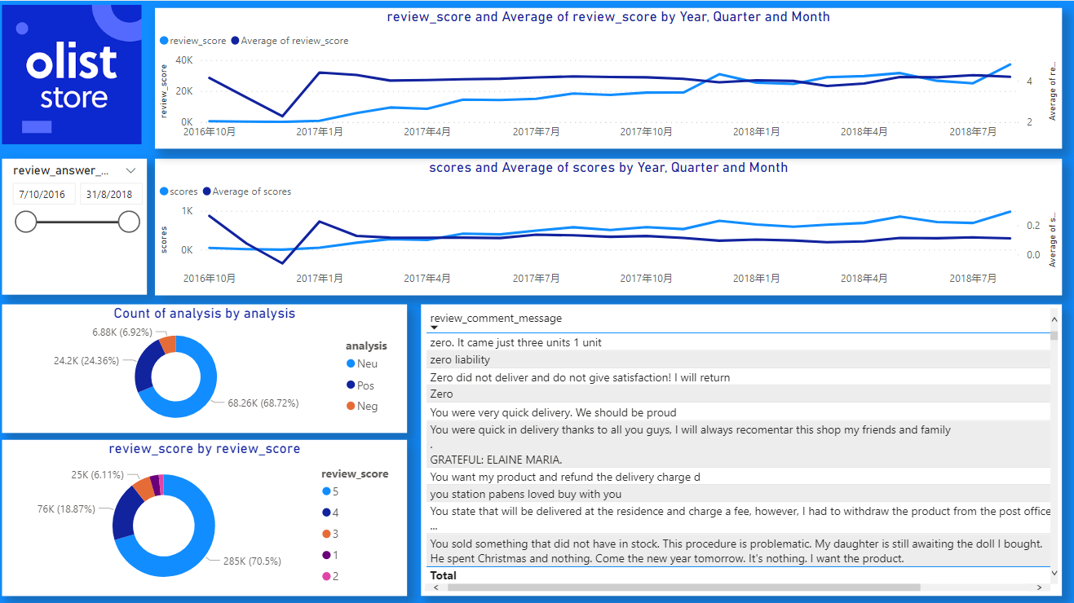
Feedback Sentiment Analysis

Slide 14
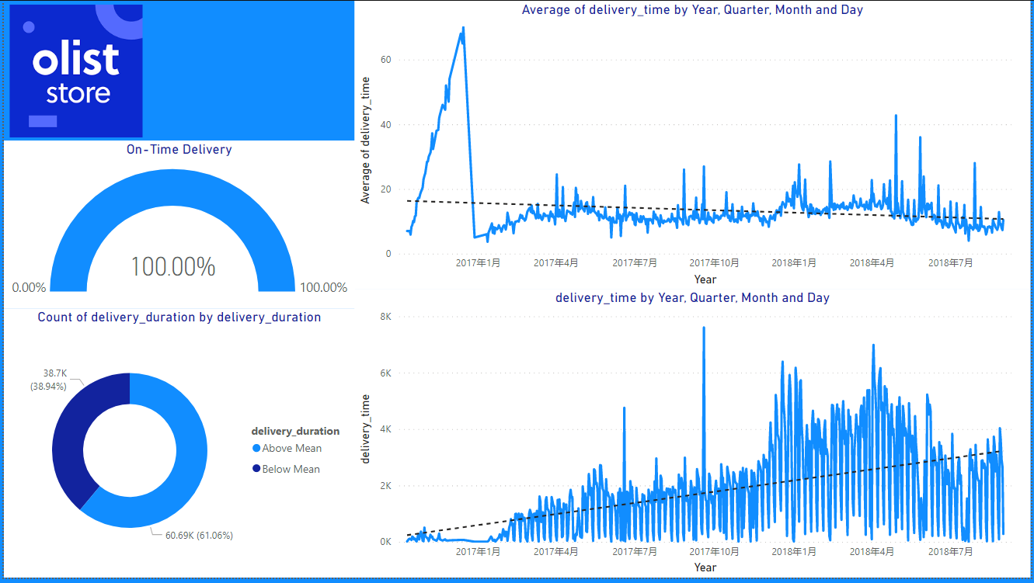
Delivery Status report

Slide 15
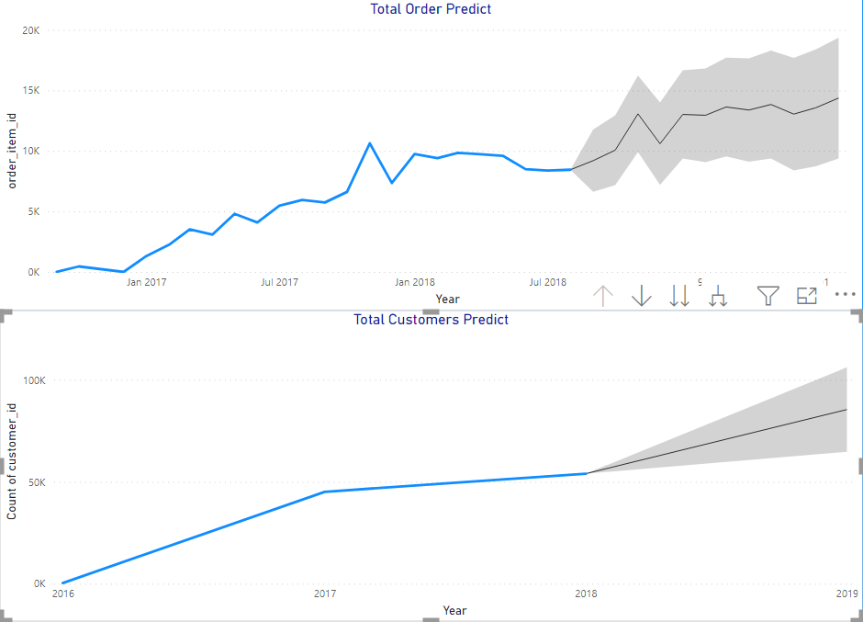
Sales Prediction

Slide 16
Demo Time

Slide 17
Based on the sentiment and prediction analysis, what should we suggest to Olist for future development?
1. Special offerings to boost overall sales on low sales period
2. Improve low sales category
3. Outsourcing drivers for delivery during Sales or Festival period
4. Investigate and Review the partner company with low review score

Slide 18
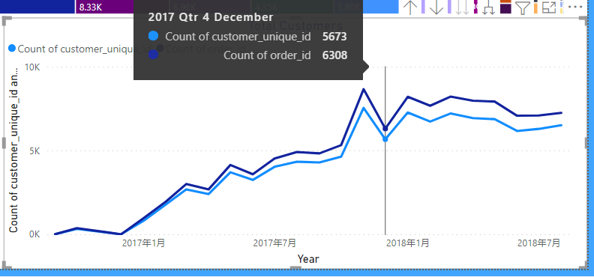
Special offerings to boost overall sales on low sales period

Slide 19


Free delivery services

Slide 20
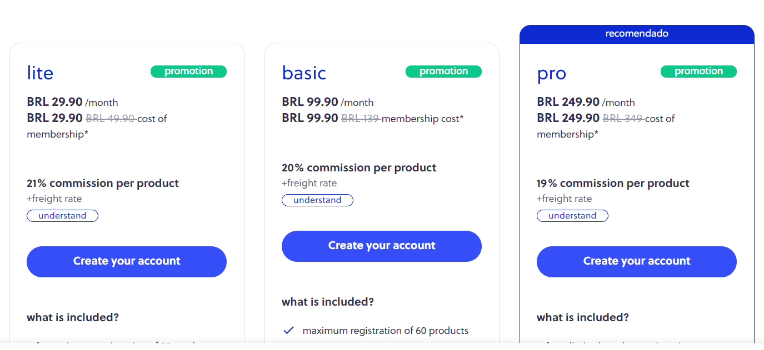
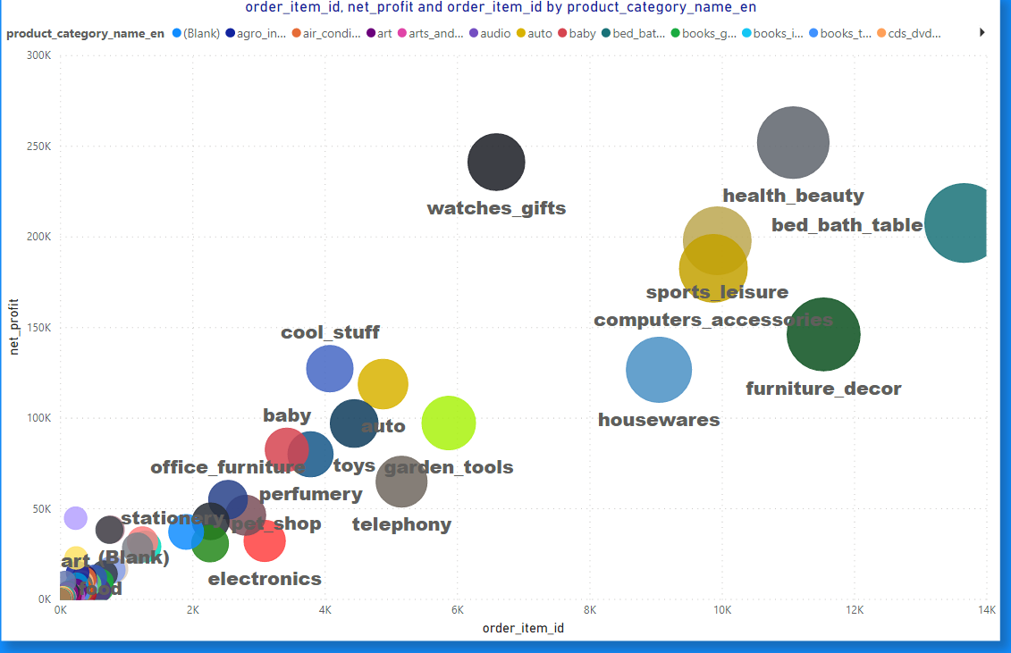
Improve low sales category

Slide 21
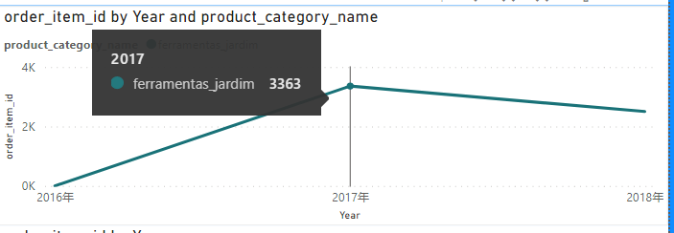
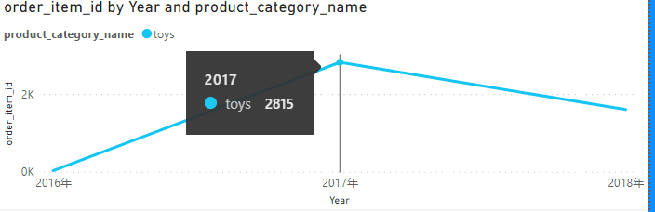
Improve low sales category

Slide 22
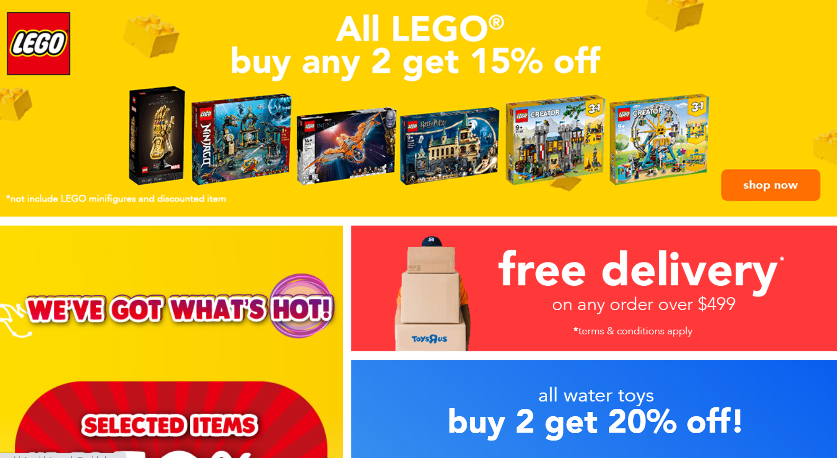


Improve low sales category, special offers, giveaways…

Slide 23
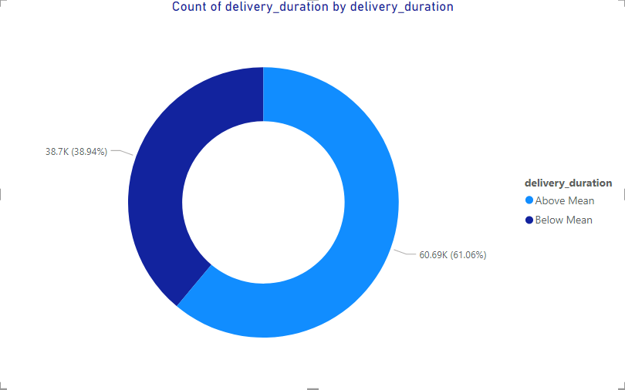
Outsourcing delivery services to others during seasonal sales periods

Slide 24


Outsourcing delivery services to others during seasonal sales periods

Slide 25
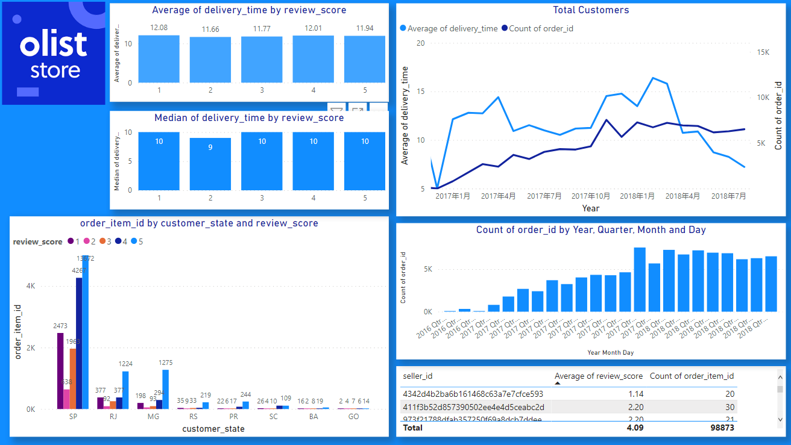
Investigate and Review the partner company with low review score

Slide 26
Limitations
Some key values are missing
Example : the delivery costs
Rules behind the freight value ?
Profit margins
Analysis are only based on the total count of the orders

